Slide 1
The Foundations: Logic and Proofs
Chapter 1, Part II: Predicate Logic
Rosen, “Discrete mathematics and its applications”
With Question/Answer Animations

Slide 2
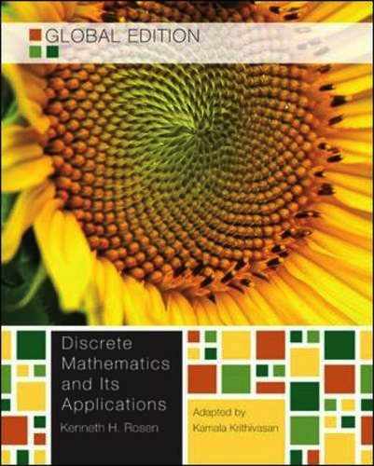
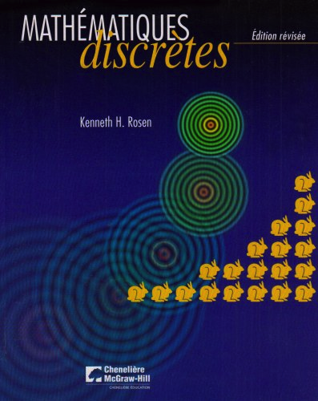
Books

Slide 3
Summary
Predicate Logic (First-Order Logic (FOL), Predicate Calculus)
The Language of Quantifiers
Logical Equivalences
Nested Quantifiers
Translation from Predicate Logic to English
Translation from English to Predicate Logic

Slide 4
Predicates and Quantifiers
Section 1.4

Slide 5
Section Summary
Predicates
Variables
Quantifiers
Universal Quantifier
Existential Quantifier
Negating Quantifiers
De Morgan’s Laws for Quantifiers
Translating English to Logic
Logic Programming (optional)

Slide 6
Propositional Logic Not Enough
If we have:
“All men are mortal.”
“Socrates is a man.”
Does it follow that “Socrates is mortal?”
Can’t be represented in propositional logic. Need a language that talks about objects, their properties, and their relations.
Later we’ll see how to draw inferences.

Slide 7
Introducing Predicate Logic
Predicate logic uses the following new features:
Variables: x, y, z
Predicates: P(x), M(x)
Quantifiers (to be covered in a few slides):
Propositional functions are a generalization of propositions.
They contain variables and a predicate, e.g., P(x)
Variables can be replaced by elements from their domain.

Slide 8
Propositional Functions
Propositional functions become propositions (and have truth values) when their variables are each replaced by a value from the domain (or bound by a quantifier, as we will see later).
The statement P(x) is said to be the value of the propositional function P at x.
For example, let P(x) denote “x > 0” and the domain be the integers. Then:
P(-3) is false.
P(0) is false.
P(3) is true.
Often the domain is denoted by U. So in this example U is the set of integers.

Slide 9
Examples of Propositional Functions
Let “x + y = z” be denoted by R(x, y, z) and U (for all three variables) be the integers. Find these truth values:
R(2,-1,5)
Solution: F
R(3,4,7)
Solution: T
R(x, 3, z)
Solution: Not a Proposition
Now let “x - y = z” be denoted by Q(x, y, z), with U as the integers. Find these truth values:
Q(2,-1,3)
Solution: T
Q(3,4,7)
Solution: F
Q(x, 3, z)
Solution: Not a Proposition

Slide 10
Compound Expressions
Connectives from propositional logic carry over to predicate logic.
If P(x) denotes “x > 0,” find these truth values:
P(3) ∨ P(-1) Solution: T
P(3) ∧ P(-1) Solution: F
P(3) → P(-1) Solution: F
P(-1) → P(-1) Solution: T
Expressions with variables are not propositions and therefore do not have truth values. For example,
P(3) ∧ P(y)
P(x) → P(y)
When used with quantifiers (to be introduced next), these expressions (propositional functions) become propositions.

Slide 11
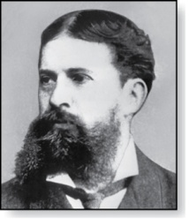
Quantifiers
Charles Peirce (1839-1914)
We need quantifiers to express the meaning of English words including all and some:
“All men are Mortal.”
“Some cats do not have fur.”
The two most important quantifiers are:
Universal Quantifier, “For all,” symbol: ∀
Existential Quantifier, “There exists,” symbol: ∃
We write ∀x P(x) and ∃x P(x).
∀x P(x) asserts P(x) is true for every x in the domain.
∃x P(x) asserts P(x) is true for some x in the domain.
The quantifiers are said to bind the variable x in these expressions.

Slide 12
Universal Quantifier
∀x P(x) is read as “For all x, P(x)” or “For every x, P(x)”
Examples:
If P(x) denotes “x > 0” and U is the integers, then ∀x P(x) is false.
If P(x) denotes “x > 0” and U is the positive integers, then ∀x P(x) is true.
If P(x) denotes “x is even” and U is the integers, then ∀ x P(x) is false.

Slide 13
Existential Quantifier
∃x P(x) is read as “For some x, P(x)”, or as “There is an x such that P(x),” or “For at least one x, P(x).”
Examples:
If P(x) denotes “x > 0” and U is the integers, then ∃x P(x) is true. It is also true if U is the positive integers.
If P(x) denotes “x < 0” and U is the positive integers, then ∃x P(x) is false.
If P(x) denotes “x is even” and U is the integers, then ∃x P(x) is true.

Slide 14
Uniqueness Quantifier (optional)
∃!x P(x) means that P(x) is true for one and only one x in the universe of discourse.
This is commonly expressed in English in the following equivalent ways:
“There is a unique x such that P(x).”
“There is one and only one x such that P(x)”
Examples:
If P(x) denotes “x + 1 = 0” and U is the integers, then ∃!x P(x) is true.
But if P(x) denotes “x > 0,” then ∃!x P(x) is false.
The uniqueness quantifier is not really needed as the restriction that there is a unique x such that P(x) can be expressed as:
∃x (P(x) ∧∀y (P(y) → y =x))

Slide 15
Thinking about Quantifiers
When the domain of discourse is finite, we can think of quantification as looping through the elements of the domain.
To evaluate ∀x P(x) loop through all x in the domain.
If at every step P(x) is true, then ∀x P(x) is true.
If at a step P(x) is false, then ∀x P(x) is false and the loop terminates.
To evaluate ∃x P(x) loop through all x in the domain.
If at some step, P(x) is true, then ∃x P(x) is true and the loop terminates.
If the loop ends without finding an x for which P(x) is true, then ∃x P(x) is false.
Even if the domains are infinite, we can still think of the quantifiers this fashion, but the loops will not terminate in some cases.

Slide 16
Properties of Quantifiers
The truth value of ∃x P(x) and ∀ x P(x) depends on both the propositional function P(x) and on the domain U.
Examples:
If U is the positive integers and P(x) is the statement “x < 2”, then ∃x P(x) is true, but ∀ x P(x) is false.
If U is the negative integers and P(x) is the statement “x < 2”, then both ∃ x P(x) and ∀ x P(x) are true.
If U consists of 3, 4, and 5, and P(x) is the statement “x > 2”, then both ∃ x P(x) and ∀ x P(x) are true. But if P(x) is the statement “x < 2”, then both ∃ x P(x) and ∀ x P(x) are false.

Slide 17
Precedence of Quantifiers
The quantifiers ∀ and ∃ have higher precedence than all the logical operators.
For example, ∀x P(x) ∨ Q(x) means (∀x P(x)) ∨ Q(x)
∀x (P(x) ∨ Q(x)) means something different.
Unfortunately, often people write ∀x P(x) ∨ Q(x) when they mean ∀ x (P(x) ∨ Q(x)).

Slide 18
Translating from English to Logic
Example 1: Translate the following sentence into predicate logic: “Every student in this class has taken a course in Java.”
Solution:
First decide on the domain U.
Solution 1: If U is all students in this class, define a propositional function J(x) denoting “x has taken a course in Java” and translate as ∀x J(x).
Solution 2: But if U is all people, also define a propositional function S(x) denoting “x is a student in this class” and translate as ∀x (S(x) → J(x)).

Slide 19
Translating from English to Logic
Example 2: Translate the following sentence into predicate logic: “Some student in this class has taken a course in Java.”
Solution:
First decide on the domain U.
Solution 1: If U is all students in this class, translate as
∃x J(x)
Solution 2: But if U is all people, then translate as ∃x (S(x) ∧ J(x))

Slide 20
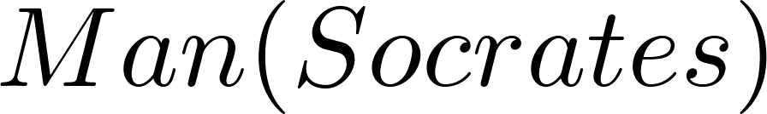
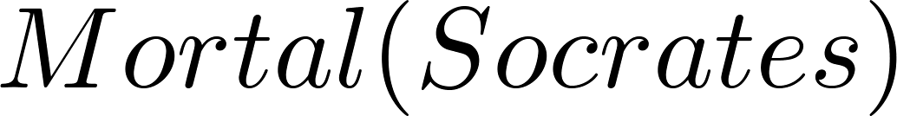
Returning to the Socrates Example
Introduce the propositional functions Man(x) denoting “x is a man” and Mortal(x) denoting “x is mortal.” Specify the domain as all people.
The two premises are:
The conclusion is:
Later we will show how to prove that the conclusion follows from the premises.

Slide 21
Equivalences in Predicate Logic
Statements involving predicates and quantifiers are logically equivalent if and only if they have the same truth value
for every predicate substituted into these statements and
for every domain of discourse used for the variables in the expressions.
The notation S ≡T indicates that S and T are logically equivalent.
Example: ∀x ¬¬S(x) ≡ ∀x S(x)

Slide 22
Thinking about Quantifiers as Conjunctions and Disjunctions
If the domain is finite, a universally quantified proposition is logically equivalent to a conjunction of propositions without quantifiers and an existentially quantified proposition is equivalent to a disjunction of propositions without quantifiers.
If U consists of the integers 1,2, and 3:
Even if the domains are infinite, you can still think of the quantifiers in this fashion, but the equivalent expressions without quantifiers will be infinitely long.

Slide 23
Negating Quantified Expressions
Consider ∀x J(x)
“Every student in your class has taken a course in Java.”
Here J(x) is “x has taken a course in Java” and
the domain is students in your class.
Negating the original statement gives “It is not the case that every student in your class has taken Java.” This means that “There is a student in your class who has not taken java.”
Symbolically ¬∀x J(x) and ∃x ¬J(x) are logically equivalent

Slide 24
Negating Quantified Expressions (continued)
Now Consider ∃ x J(x)
“There is at least a student in this class who has taken a course in Java.”
Where J(x) is “x has taken a course in Java.”
Negating the original statement gives “It is not the case that there is a student in this class who has taken Java.” This implies that “Every student in this class has not taken Java”
Symbolically ¬∃ x J(x) and ∀ x ¬J(x) are logically equivalent

Slide 25
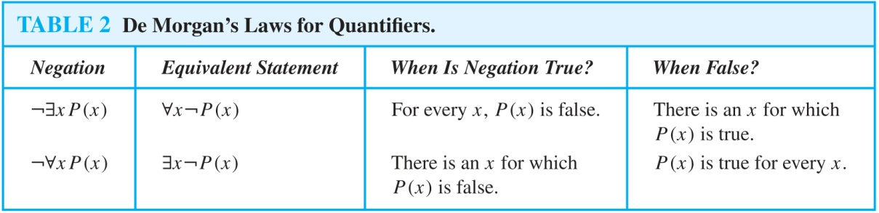
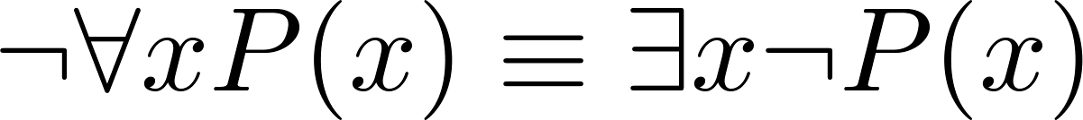
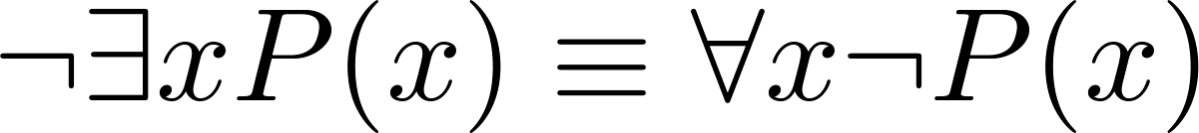
De Morgan’s Laws for Quantifiers
The rules for negating quantifiers are:
It means that:

Slide 26
Translation from English to Logic
Examples:
“Some student in this class has visited Mexico.”
Solution: Let M(x) denote “x has visited Mexico” and S(x) denote “x is a student in this class,” and U be all people.
∃x (S(x) ∧ M(x))
“Every student in this class has visited Canada or Mexico.”
Solution: Add C(x) denoting “x has visited Canada.”
∀x (S(x)→ (M(x) ∨ C(x)))

Slide 27
Some Fun with Translating from English into Logical Expressions
U = {fleegles, snurds, thingamabobs}
F(x): x is a fleegle
S(x): x is a snurd
T(x): x is a thingamabob
Translate “Everything is a fleegle”
Solution: ∀x F(x)

Slide 28
Translation (cont)
U = {fleegles, snurds, thingamabobs}
F(x): x is a fleegle
S(x): x is a snurd
T(x): x is a thingamabob
“Nothing is a snurd.”
Solution: ¬∃x S(x) What is this equivalent to?
Solution: ∀x ¬ S(x)

Slide 29
Translation (cont)
U = {fleegles, snurds, thingamabobs}
F(x): x is a fleegle
S(x): x is a snurd
T(x): x is a thingamabob
“All fleegles are snurds.”
Solution: ∀x (F(x) → S(x))

Slide 30
Translation (cont)
U = {fleegles, snurds, thingamabobs}
F(x): x is a fleegle
S(x): x is a snurd
T(x): x is a thingamabob
“Some fleegles are thingamabobs.”
Solution: ∃x (F(x) ∧ T(x))

Slide 31
Translation (cont)
U = {fleegles, snurds, thingamabobs}
F(x): x is a fleegle
S(x): x is a snurd
T(x): x is a thingamabob
“No snurd is a thingamabob.”
Solution: ¬∃x (S(x) ∧ T(x)) What is this equivalent to?
Solution: ∀x (¬S(x) ∨ ¬T(x))

Slide 32
Translation (cont)
U = {fleegles, snurds, thingamabobs}
F(x): x is a fleegle
S(x): x is a snurd
T(x): x is a thingamabob
“If any fleegle is a snurd then it is also a thingamabob.”
Solution: ∀x ((F(x) ∧ S(x)) → T(x))

Slide 33
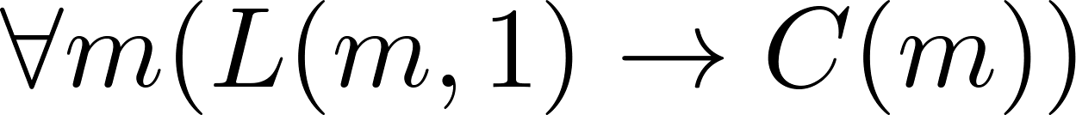
System Specification Example
Predicate logic is used for specifying properties that systems must satisfy.
For example, translate into predicate logic:
“Every mail message larger than one megabyte will be compressed.”
“If a user is active, then at least one network link will be available.”
Decide on predicates and domains (left implicit here) for the variables:
Let L(m, y) be “Mail message m is larger than y megabytes.”
Let C(m) denote “Mail message m will be compressed.”
Let A(u) represent “User u is active.”
Let S(n, x) represent “Network link n is state x.
Now we have:

Slide 34
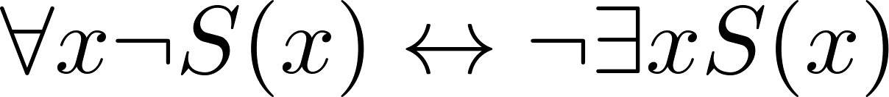
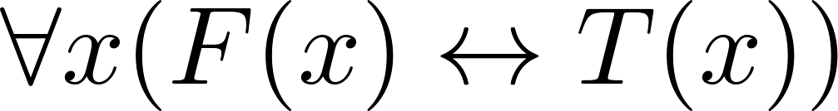
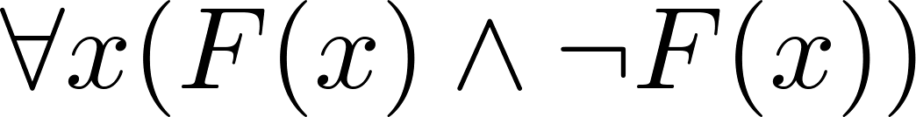
Some Predicate Calculus Definitions
An assertion involving predicates and quantifiers is valid if it is true
for all domains
every propositional function substituted for the predicates in the assertion.
Example:
An assertion involving predicates is satisfiable if it is true
for some domains
some propositional functions that can be substituted for the predicates in the assertion.
Otherwise it is unsatisfiable.
Example: not valid but satisfiable
Example: unsatisfiable

Slide 35
Logic Programming
Prolog (from Programming in Logic) is a programming language developed in the 1970s by researchers in artificial intelligence (AI).
Prolog programs include Prolog facts and Prolog rules.
As an example of a set of Prolog facts consider the following:
instructor(chan, math273).
instructor(patel, ee222).
instructor(grossman, cs301).
enrolled(kevin, math273).
enrolled(juna, ee222).
enrolled(juana, cs301).
enrolled(kiko, math273).
enrolled(kiko, cs301).
Here the predicates instructor(p,c) and enrolled(s,c) represent that professor p is the instructor of course c and that student s is enrolled in course c.

Slide 36
Logic Programming (cont)
In Prolog, names beginning with an uppercase letter are variables.
If we have a predicate teaches(p,s) representing “professor p teaches student s,” we can write the rule:
teaches(P,S) :- instructor(P,C), enrolled(S,C).
This Prolog rule can be viewed as equivalent to the following statement in logic (using our conventions for logical statements).
∀p ∀c ∀s (I(p,c) ∧ E(s,c)) → T(p,s))

Slide 37
Logic Programming (cont)
Prolog programs are loaded into a Prolog interpreter. The interpreter receives queries and returns answers using the Prolog program.
For example, using our program, the following query may be given:
?enrolled(kevin,math273).
Prolog produces the response:
yes
Note that the ? is the prompt given by the Prolog interpreter indicating that it is ready to receive a query.

Slide 38
Logic Programming (cont)
The query:
?enrolled(X,math273).
produces the response:
X = kevin;
X = kiko;
no
The query:
?teaches(X,juana).
produces the response:
X = patel;
X = grossman;
no
The Prolog interpreter tries to find an instantiation for X. It does so and returns X = kevin. Then the user types the ; indicating a request for another answer. When Prolog is unable to find another answer it returns no.

Slide 39
Logic Programming (cont)
The query:
?teaches(chan,X).
produces the response:
X = kevin;
X = kiko;
no
A number of very good Prolog texts are available. Learn Prolog Now! is one such text with a free online version at http://www.learnprolognow.org/
There is much more to Prolog and to the entire field of logic programming.

Slide 40
L’histoire du bar
Six collègues de travail entrent dans un bar pour boire un verre. Toutes les tables sont prises et il n’y a plus que six tabourets au comptoir. Ils vont pouvoir s’asseoir mais souhaiteraient optimiser leurs discussions pour que chacun ait des choses à dire à son voisin.
Ils ne veulent en aucun cas parler “boulot” et choisissent de partir sur leurs passions respectives pour trouver la meilleure disposition.

Slide 41
Prénom | Passion(s)
Mathieu | Foot et Jeux vidéos
Etienne | Escalade, Jeux vidéos et Matrices
Alex | Oiseaux et Livres
Nico | Foot
Bertrand | Matrices
Marco | Livres et Matrices
L’histoire du bar

Slide 42
Concepts PROLOG
Les faits
Une situation qui est vrai pour l’univers en question. Peut être apparenté à une proposition.
Ex: Mathieu a comme passion le foot
sera exprimé en PROLOG
passion(mathieu, foot).
Les règles (relations)
Exprime une question à laquelle l’interpréteur peut répondre à l’aide de faits.
Ex: 2 pers. peuvent discuter si elles ont une passion en commun
sera exprimé en PROLOG
discussion(A, B) :- passion(A, P), passion(B, P).

Slide 43
Les faits
passion(mathieu, foot). passion(mathieu, jeux). passion(nico, foot). passion(alex, oiseaux). passion(alex, livres). passion(marco, matrices). passion(marco, livres). passion(bertrand, matrices). passion(etienne, jeux). passion(etienne, escalade). passion(etienne, matrices).
Les règles
discussion(A, B) :- passion(A, P), passion(B, P), not(A=B). arrangement(A,B,C,D,E,F) :- discussion(A,B),discussion(B,C),discussion(C,D),discussion(D,E),discussion(E,F), not(A=B),not(A=C),not(A=D),not(A=E),not(A=F), not(B=C),not(B=D),not(B=E),not(B=F), not(C=D),not(C=E),not(C=F), not(D=E),not(D=F), not(E=F).
Résolution du problème en PROLOG

Slide 44
Nested Quantifiers
Section 1.5

Slide 45
Section Summary
Nested Quantifiers
Order of Quantifiers
Translating from Nested Quantifiers into English
Translating Mathematical Statements into Statements involving Nested Quantifiers.
Translated English Sentences into Logical Expressions.
Negating Nested Quantifiers.

Slide 46
Nested Quantifiers
Nested quantifiers are often necessary to express the meaning of sentences in English as well as important concepts in computer science and mathematics.
Example: “Every real number has an inverse” is
∀x ∃y(x + y = 0)
where the domains of x and y are the real numbers.
We can also think of nested propositional functions:
∀x ∃y(x + y = 0) can be viewed as ∀x Q(x) where Q(x) is ∃y P(x, y) where P(x, y) is (x + y = 0)

Slide 47
Thinking of Nested Quantification
Nested Loops
To see if ∀x ∀y P(x,y) is true, loop through the values of x :
At each step, loop through the values for y.
If for some pair of x and y, P(x,y) is false, then ∀x ∀yP(x,y) is false and both the outer and inner loop terminate.
∀x ∀y P(x,y) is true if the outer loop ends after stepping through each x.
To see if ∀x ∃y P(x,y) is true, loop through the values of x:
At each step, loop through the values for y.
The inner loop ends when a pair x and y is found such that P(x, y) is true.
If no y is found such that P(x, y) is true the outer loop terminates as ∀x ∃yP(x,y) has been shown to be false.
∀x ∃y P(x,y) is true if the outer loop ends after stepping through each x.
If the domains of the variables are infinite, then this process can not actually be carried out.

Slide 48
Order of Quantifiers
Examples:
Let P(x,y) be the statement “x + y = y + x.” Assume that U is the real numbers. Then ∀x ∀y P(x,y) and ∀y ∀x P(x,y) have the same truth value.
Let Q(x,y) be the statement “x + y = 0.” Assume that U is the real numbers. Then ∀x ∃y P(x,y) is true, but ∃y ∀x P(x,y) is false.

Slide 49
Questions on Order of Quantifiers
Example 1: Let U be the real numbers,
Define P(x,y) : x ∙ y = 0
What is the truth value of the following:
∀x ∀y P(x,y)
Answer: False
∀x ∃y P(x,y)
Answer: True
∃x ∀y P(x,y)
Answer: True
∃x ∃y P(x,y)
Answer: True

Slide 50
Questions on Order of Quantifiers
Example 2: Let U be the real numbers,
Define P(x,y) : x / y = 1
What is the truth value of the following:
∀x ∀y P(x,y)
Answer: False
∀x ∃y P(x,y)
Answer: True
∃x ∀y P(x,y)
Answer: False
∃x ∃ y P(x,y)
Answer: True

Slide 51
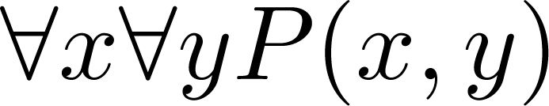
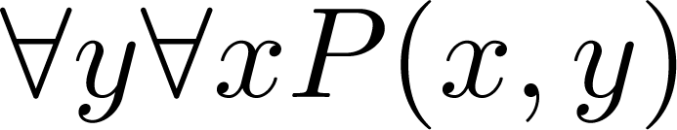
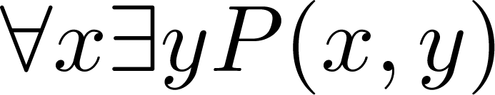
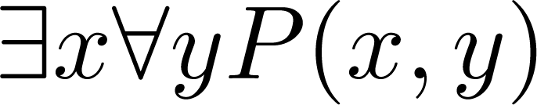
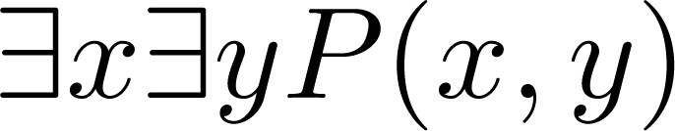
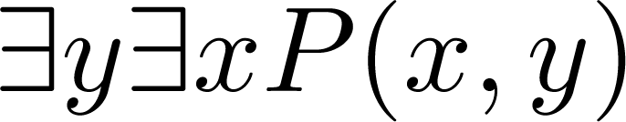
Quantifications of Two Variables
Statement | When True? | When False
 | P(x,y) is true for every pair x,y. | There is a pair x, y for which P(x,y) is false.
 | For every x there is a y for which P(x,y) is true. | There is an x such that P(x,y) is false for every y.
 | There is an x for which P(x,y) is true for every y. | For every x there is a y for which P(x,y) is false.
 | There is a pair x, y for which P(x,y) is true. | P(x,y) is false for every pair x,y

Slide 52
Translating Nested Quantifiers into English
Example 1: Translate the statement
∀x (C(x) ∨ ∃y (C(y) ∧ F(x, y)))
where C(x) is “x has a computer,” and F(x,y) is “x and y are friends,” and the domain for both x and y consists of all students in your school.
Solution: Every student in your school has a computer or has a friend who has a computer.
Example 2: Translate the statement
∃x∀y ∀z ((F(x,y) ∧ F(x,z) ∧ (y ≠z))→¬F(y,z))
Solution: There is a student for which none of whose friends are also friends with each other.

Slide 53
Translating Mathematical Statements into Predicate Logic
Example : Translate “The sum of two positive integers is always positive” into a logical expression.
Solution:
Rewrite the statement to make the implied quantifiers and domains explicit:
“For every two integers, if these integers are both positive, then the sum of these integers is positive.”
Introduce the variables x and y, and specify the domain, to obtain:
“For all positive integers x and y, x + y is positive.”
The result is:
∀x ∀ y ((x > 0)∧ (y > 0)→ (x + y > 0))
where the domain of both variables consists of all integers

Slide 54
Questions on Translation from English
Choose the obvious predicates and express in predicate logic.
Example 1: “Brothers are siblings.”
Solution: ∀x ∀y (B(x,y) → S(x,y))
Example 2: “Siblinghood is symmetric.”
Solution: ∀x ∀y (S(x,y) → S(y,x))
Example 3: “Everybody loves somebody.”
Solution: ∀x ∃y L(x,y)
Example 4: “There is someone who is loved by everyone.”
Solution: ∃y ∀x L(x,y)
Example 5: “There is someone who loves someone.”
Solution: ∃x ∃y L(x,y)
Example 6: “Everyone loves himself”
Solution: ∀x L(x,x)

